Slide 1

Priority Queues (Heaps)
CS 2321
Data Structures and Algorithms
Dr. Mahdi Khemakhem

Slide 2
Outlines
Priority Queues Model
Implementation of Priority Queues
Binary Heap

Slide 3
1. Priority Queues Model
Reading: Text Book (Weiss) 6.1

Slide 4
Priority Queue (Heap)
A kind of queue
Dequeue gets element with the highest priority
Priority is based on a comparable value (key) of each object (smaller value higher priority, or higher value higher priority)
Example Applications:
printer -> print (dequeue) the shortest document first
operating system -> run (dequeue) the shortest job first
normal queue -> dequeue the first enqueued element first

Slide 5
Priority Queue (Heap) Operations
deleteMin
Priority Queue
insert
insert (enqueue)
deleteMin (dequeue)
smaller value higher priority
Find / save the minimum element, delete it from structure and return it

Slide 6
2. Implementation of Priority Queues
Reading: Text Book (Weiss) 6.2

Slide 7
Implementation using Linked List
Unsorted linked list
insert takes O(1) time
deleteMin takes O(N) time
Sorted linked list
insert takes O(N) time
deleteMin takes O(1) time

Slide 8
Implementation using Binary Search Tree
insert takes O(log N) time on the average
deleteMin takes O(log N) time on the average
support other operations that are not required by priority queue (for example, findMax)
deleteMin operations make the tree unbalanced

Slide 9
3. Binary Heap
Reading: Text Book (Weiss) 6.3

Slide 10
Binary Heap Implementation
Property 1: Structure Property
Binary tree & completely filled (bottom level is filled from left to right) (complete binary tree)
if height is h, a complete binary tree has between 2^{h} and 2^{h+1}-1 nodes
A
B
C
D
E
F
G
H
I
J

Slide 11
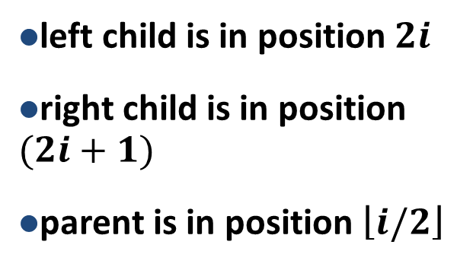
Array Implementation of Binary Heap
A
B
C
D
E
F
G
H
I
J
A
B
C
D
E
F
G
H
I
J
0
1
2
3
4
5
6
7
8
9
10
11
12
13

Slide 12
Property 2: Heap Order Property (for Minimum Heap)
Any node is smaller than (or equal to) all of its children (any subtree is a heap)
Smallest element is at the root (findMin take O(1) time)
By the heap-order property, the minimum element can always be found at the root
13
21
16
24
31
19
68
65
26
32

Slide 13
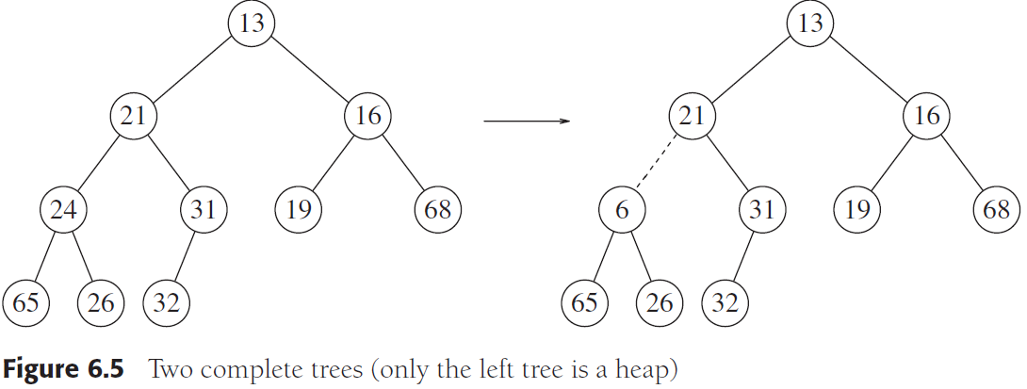
Property 2: Heap Order Property (for Minimum Heap)
Any node is smaller than (or equal to) all of its children (any subtree is a heap)

Slide 14
Insert
Create a hole in the next available location
Move the hole up (swap with its parent) until data can be placed in the hole without violating the heap order property (called percolate up)
13
21
16
13
24
31
19
68
21
16
65
26
32
24
19
68
65
26
32
31

Slide 15
Insert
insert 14
13
21
16
13
24
31
19
68
21
16
24
19
68
65
26
32
65
26
32
31
Percolate Up -> move the place to put 14 up
(move its parent down) until its parent <= 14

Slide 16
Insert
13
16
24
21
19
68
13
65
26
32
31
14
16
24
21
19
68
65
26
32
31

Slide 17
deleteMin
Create a hole at the root
Move the hole down (swap with the smaller one of its children) until the last element of the heap can be placed in the hole without violating the heap order property (called percolate down)
13
14
16
19
21
19
68
14
16
65
26
32
31
19
21
19
68
65
26
32
31

Slide 18
deleteMin
13
14
16
19
21
19
68
14
16
19
21
19
68
65
26
32
31
65
26
32
31
Percolate Down -> move the place to put 31 down (move its smaller child up) until its children >= 31

Slide 19
deleteMin
14
16
19
21
19
68
14
65
26
32
31
19
16
21
19
68
65
26
32
31

Slide 20
deleteMin
14
19
16
26
21
19
68
65
32
31
14
19
16
26
21
19
68
65
31
32

Slide 21
Running Time
insert
worst case: takes O(log N) time.
deleteMin
worst case: takes O(log N) time.

Slide 22
Building a Heap
Sometimes it is required to construct it from an initial collection of items O(NlogN) in the worst case.
But insertions take O(1) on the average.
Hence the question: is it possible to do any better?

Slide 23
buildHeap Algorithm
General Algorithm
Place the N items into the tree in any order, maintaining the structure property.
Call buildHeap
void buildHeap( PriorityQueue H, int N )
{
int i;
for( i = N / 2; i > 0; i-- )
percolateDown( H, i );
}

Slide 25
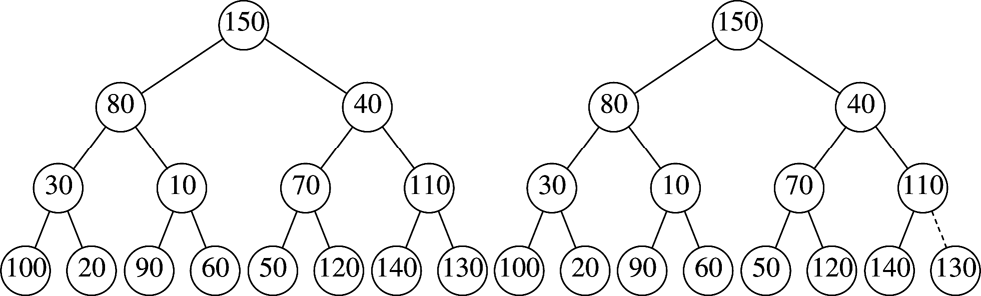
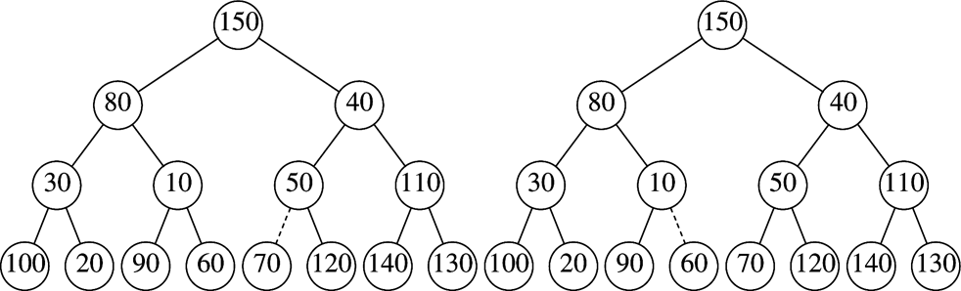
buildHeap Example - I
initial
heap
after
percolateDown(7)
after
percolateDown(6)
after
percolateDown(5)

Slide 26
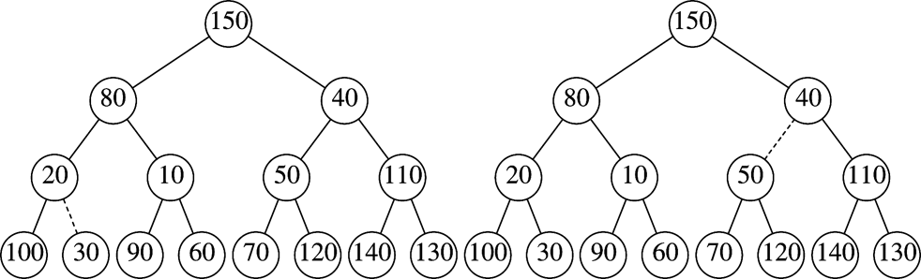
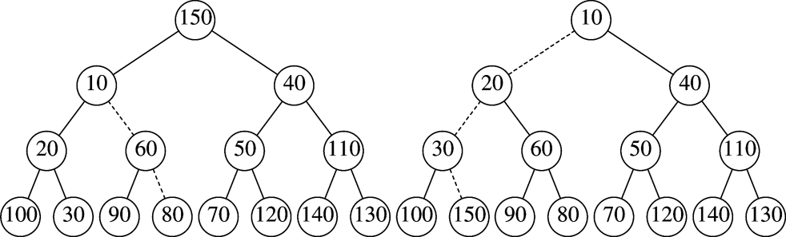
buildHeap Example - II
after
percolateDown(4)
after
percolateDown(3)
after
percolateDown(2)
after
percolateDown(1)

Slide 27
Implementation in C - HeapStruct
#define MinPQSize (10)
#define MinData (-32767)
typedef int ElementType;
struct HeapStruct
{
int Capacity;
int Size;
ElementType *Elements;
};
typedef struct HeapStruct *PriorityQueue;

Slide 28
Implementation in C - Initialize
PriorityQueue Initialize( int MaxElements )
{
PriorityQueue H;
if( MaxElements < MinPQSize )
Error( "Priority queue size is too small" );
H = malloc( sizeof( struct HeapStruct ) );
if( H ==NULL ) FatalError( "Out of space!!!" );
/* Allocate the array plus one extra for sentinel */
H->Elements = malloc((MaxElements + 1)*sizeof(ElementType));
if( H->Elements == NULL ) FatalError( "Out of space!!!" );
H->Capacity = MaxElements;
H->Size = 0;
H->Elements[ 0 ] = MinData;
return H;
}

Slide 29
Implementation in C – IsEmpty, IsFull
int IsEmpty( PriorityQueue H )
{
return H->Size == 0;
}
int IsFull( PriorityQueue H )
{
return H->Size == H->Capacity;
}

Slide 30
Implementation in C – Insert
/* H->Element[ 0 ] is a sentinel */
void Insert( ElementType X, PriorityQueue H )
{
int i;
if( IsFull( H ) )
{
Error( "Priority queue is full" );
return;
}
for( i = ++H->Size; H->Elements[ i / 2 ] > X; i /= 2 )
H->Elements[ i ] = H->Elements[ i / 2 ];
H->Elements[ i ] = X;
}

Slide 31
Implementation in C – DeleteMin
ElementType DeleteMin( PriorityQueue H )
{
ElementType MinElement;
if( IsEmpty( H ) )
{
Error( "Priority queue is empty" );
return H->Elements[0];
}
MinElement = H->Elements[ 1 ];
H->Elements[ 1 ] = H->Elements[ H->Size-- ];
percolateDown( H, 1 );
return MinElement;
}

Slide 32
Implementation in C – percolateDown
void percolateDown( PriorityQueue H, int hole )
{
int child;
ElementType tmp = H->Elements[ hole ];
for( ; hole * 2 <= H->Size; hole = child )
{
/* Find smaller child */
child = hole * 2;
if (child != H->Size && H->Elements[child+1]<H->Elements[child])
child++;
/* Percolate one level */
if( tmp > H->Elements[child] )
H->Elements[ hole ] = H->Elements[ child ];
else
break;
}
H->Elements[ hole ] = tmp;
}

